Slide 1
Informed Search/Heuristic Search
Mr. Ali Haider
Lab Instructor
Institute of Management Sciences, Peshawar.

Slide 2
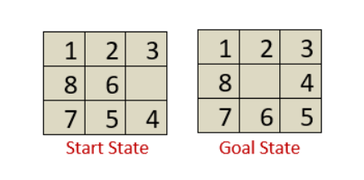
Heuristic Functions in Artificial Intelligence
As we have already seen that an informed search make use of heuristic functions in order to reach the goal node in a more prominent way.
Therefore, there are several pathways in a search tree to reach the goal node from the current node.
The selection of a good heuristic function matters certainly. A good heuristic function is determined by its efficiency. More is the information about the problem, more is the processing time.
Some toy problems, such as 8-puzzle, 8-queen, tic-tac-toe, etc., can be solved more efficiently with the help of a heuristic function. Let’s see how:

Slide 3
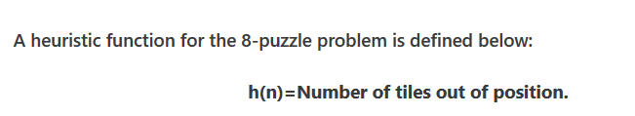
Heuristic Functions in Artificial Intelligence
Consider the following 8-puzzle problem where we have a start state and a goal state.
Our task is to slide the tiles of the current/start state and place it in an order followed in the goal state.
There can be four moves either left, right, up, or down.
There can be several ways to convert the current/start state to the goal state, but, we can use a heuristic function h(n) to solve the problem more efficiently.

Slide 4
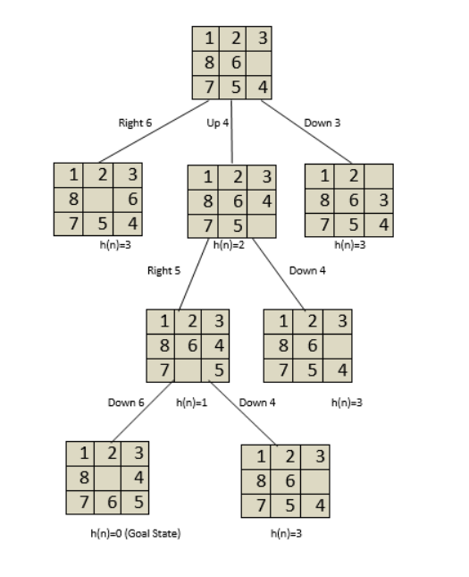
Heuristic Functions in Artificial Intelligence
So, there is total of three tiles out of position i.e., 6,5 and 4.
Do not count the empty tile present in the goal state). i.e. h(n)=3. Now, we require to minimize the value of h(n) =0.
We can construct a state-space tree to minimize the h(n) value to 0, as shown below:

Slide 5
Heuristic Functions in Artificial Intelligence
It is seen from the above state space tree that the goal state is minimized from h(n)=3 to h(n)=0.
However, we can create and use several heuristic functions as per the reqirement.
It is also clear from the above example that a heuristic function h(n) can be defined as the information required to solve a given problem more efficiently.
The information can be related to the nature of the state, cost of transforming from one state to another, goal node characterstics, etc., which is expressed as a heuristic function.

Slide 6
Properties of a Heuristic search Algorithm
Use of heuristic function in a heuristic search algorithm leads to following properties of a heuristic search algorithm:
Admissible Condition: An algorithm is said to be admissible, if it returns an optimal solution.
Completeness: An algorithm is said to be complete, if it terminates with a solution (if the solution exists).
Dominance Property: If there are two admissible heuristic algorithms A1 and A2 having h1 and h2 heuristic functions, then A1 is said to dominate A2 if h1 is better than h2 for all the values of node n.
Optimality Property: If an algorithm is complete, admissible, and dominating other algorithms, it will be the best one and will definitely give an optimal solution.

Slide 7
Informed Search/Heuristic Search
An informed search is more efficient than an uninformed search because in informed search, along with the current state information, some additional information is also present, which make it easy to reach the goal state.
Below we have discussed different types of informed search:
Best-First Search or Greedy Search
A* Algorithm

Slide 8
Best-first Search (Greedy search)
A best-first search is a general approach of informed search. Here, a node is selected for expansion based on an evaluation function f(n), where f(n) interprets the cost estimate value.
The evaluation function expands that node first, which has the lowest cost.
A component of f(n) is h(n) which carries the additional information required for the search algorithm, i.e.,
h(n)= estimated cost of the cheapest path from the current node n to the goal node.
Note: If the current node n is a goal node, the value of h(n) will be 0.
Best-first search is known as a greedy search because it always tries to explore the node which is nearest to the goal node and selects that path, which gives a quick solution. Thus, it evaluates nodes with the help of the heuristic function, i.e., f(n)=h(n).

Slide 9
Best-first search Algorithm
Set an OPEN list and a CLOSE list where the OPEN list contains visited but unexpanded nodes and the CLOSE list contains visited as well as expanded nodes.
Initially, traverse the root node and visit its next successor nodes and place them in the OPEN list in ascending order of their heuristic value.
Select the first successor node from the OPEN list with the lowest heuristic value and expand further.
Now, rearrange all the remaining unexpanded nodes in the OPEN list and repeat above two steps.
If the goal node is reached, terminate the search, else expand further.

Slide 10
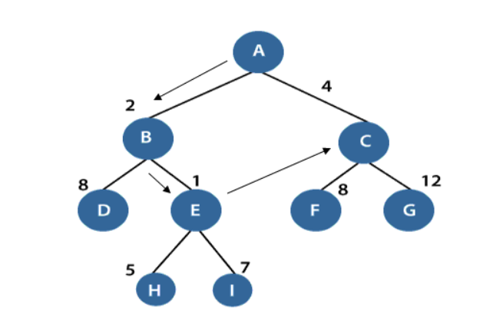
Best-first search Algorithm
In the above figure, the root node is A, and its next level successor nodes are B and C with h(B)=2 and h(C)=4.
Our task is to explore that node which has the lowest h(n) value. So, we will select node B and expand it further to node D and E.
Again, search out that node which has the lowest h(n) value and explore it further.

Slide 11
The performance measure of Best-first search Algorithm:
Completeness: Best-first search is incomplete even in finite state space.
Optimality: It does not provide an optimal solution.
Time and Space complexity: It has O(b^{m}) worst time and space complexity, where m is the maximum depth of the search tree. If the quality of the heuristic function is good, the complexities could be reduced substantially.
Note: Best first searches combines the advantage of BFS and DFS to find the best solution.

Slide 12
The performance measure of Best-first search Algorithm:
Completeness: Best-first search is incomplete even in finite state space.
Optimality: It does not provide an optimal solution.
Time and Space complexity: It has O(b^{m}) worst time and space complexity, where m is the maximum depth of the search tree.
If the quality of the heuristic function is good, the complexities could be reduced substantially.
Note: Best first searches combines the advantage of BFS and DFS to find the best solution.

Slide 13
Disadvantages of Best-first search
BFS does not guarantees to reach the goal state.
Since the best-first search is a greedy approach, it does not give an optimized solution.
It may cover a long distance in some cases.

Slide 14
A* Search Algorithm
A* search is the most widely used informed search algorithm where a node n is evaluated by combining values of the functions g(n)and h(n).
The function g(n) is the path cost from the start/initial node to a node n and h(n) is the estimated cost of the cheapest path from node n to the goal node. Therefore, we have
f(n)=g(n)+h(n)
where f(n) is the estimated cost of the cheapest solution through n. So, in order to find the cheapest solution, try to find the lowest values of f(n).

Slide 15
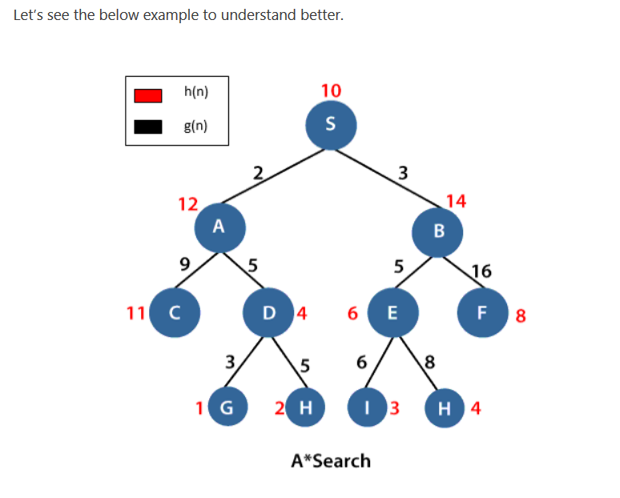
A* Search Algorithm
In the above example, S is the root node, and G is the goal node. Starting from the root node S and moving towards its next successive nodes A and B. In order to reach the goal node G, calculate the f(n) value of node S, A and B using the evaluation equation i.e. f(n)=g(n)+h(n)
Calculation of f(n) for node S: f(S)=(distance from node S to S) + h(S)=0+10=10.
Calculation of f(n) for node A: f(A)=(distance from node S to A)+h(A) = 2+12=14
Calculation of f(n) for node B: f(B)=(distance from node S to B)+h(B) = 3+14=17
Therefore, node A has the lowest f(n) value.
Hence, node A will be explored to its next level nodes C and D and again calculate the lowest f(n) value. After calculating, the sequence we get is S->A–>D->G with f(n)=13(lowest value).

Slide 16
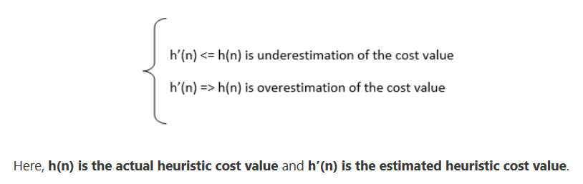
How to make A* search admissible to get an optimized solution?
A* search finds an optimal solution as it has the admissible heuristic function h(n) which believes that the cost of solving a problem is less than its actual cost.
A heuristic function can either underestimate or overestimate the cost required to reach the goal node.
But an admissible heuristic function never overestimates the cost value required to reach the goal state. Underestimating the cost value means the cost we assumed in our mind is less than the actual cost, while, overestimating the cost value means the cost we assumed is greater than the actual cost

Slide 17
The performance measure of A* search
Completeness: The star(*) in A* search guarantees to reach the goal node.
Optimality: An underestimated cost will always give an optimal solution.
Space and time complexity: A* search has O(b^{d}) space and time complexities.

Slide 18
References
https://www.tutorialandexample.com/informed-search-heuristic-search/

